Slide 1
Overview
Traditionally designed to handle classification as well as regression tasks
Historically, training was computationally expensive
Renewed interest because of reduction in computing cost
Will focus on the most basic neural network architecture

Slide 2
Neurons: Biological

Slide 3
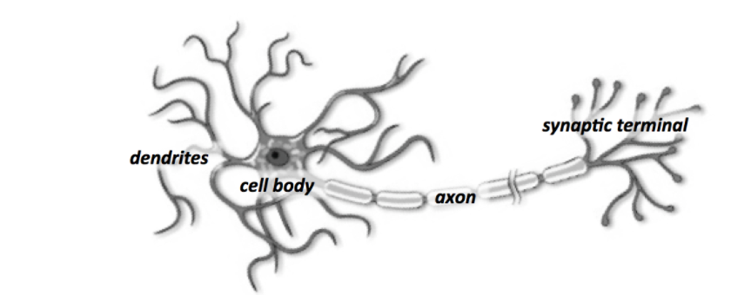
Neurons: Biological

Slide 4
Neurons: Biological

Slide 5
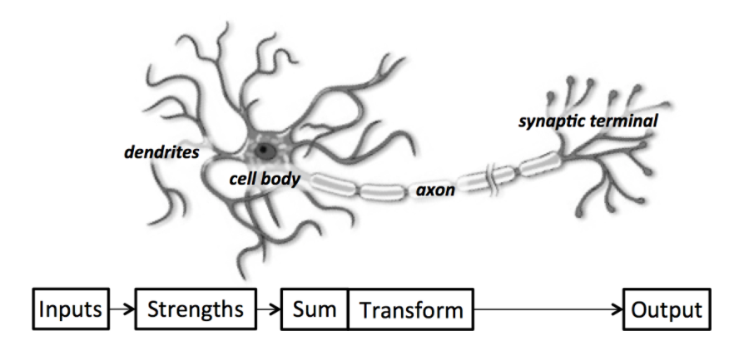
Neurons: Biological

Slide 6
Neurons: Artificial

Slide 7
Neurons: Artificial

Slide 8
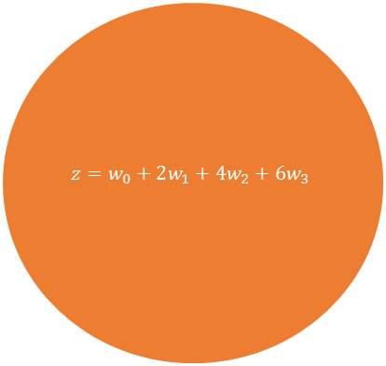
Neurons: Artificial
2
$$z=w_{0}+2w_{1}+4w_{2}+6w_{3}$$
w1
McCulloch-Pitts Neuron
4
w2
Inputs
w3
6

Slide 9
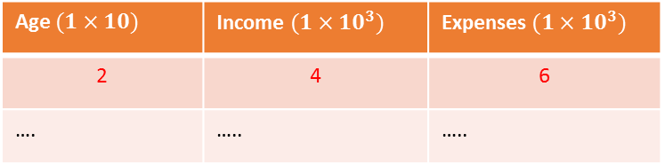
Neurons: Artificial
2
Age $(1×10)$ | Income $(1×10^{3})$ | Expenses $(1×10^{3})$
2 | 4 | 6
…. | ….. | …..
$$z=w_{0}+2w_{1}+4w_{2}+6w_{3}$$
w1
4
w2
Inputs
w3
6

Slide 10
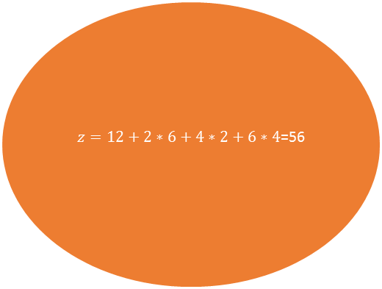
Neurons: Artificial
2
$z=12+2∗6+4∗2+6∗4$=56
6
4
2
Inputs
4
6

Slide 11
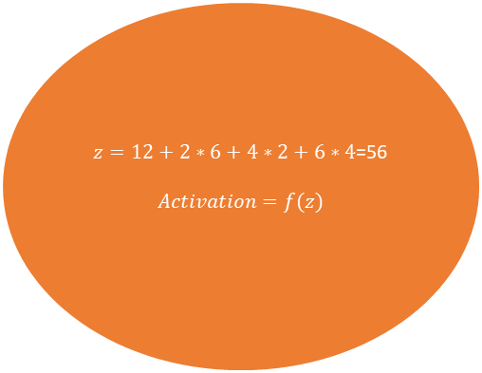
Neurons: Artificial
2
$$z=12+2∗6+4∗2+6∗4\text{=56}$$
$$Activation=f(z)$$
w1=6
4
w2=2
Inputs
w3=4
6

Slide 12
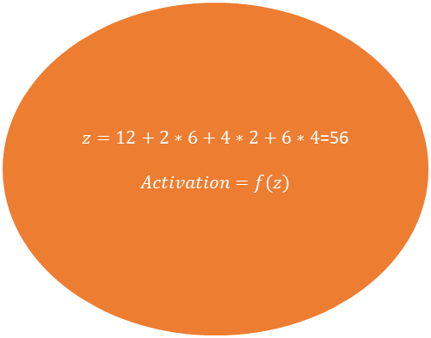
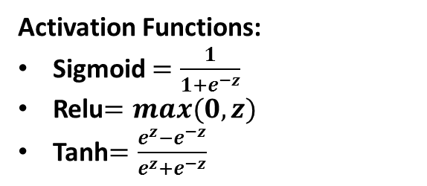
Neurons: Artificial
2
$$z=12+2∗6+4∗2+6∗4\text{=56}$$
$$Activation=f(z)$$
w1=6
Activation Functions:
Sigmoid $=\frac{1}{{1+e}^{−z}}$
Relu$=max(0,z)$
Tanh$=\frac{e^{z}−e^{−z}}{e^{z}+e^{−z}}$
4
w2=2
Inputs
w3=4
6

Slide 13
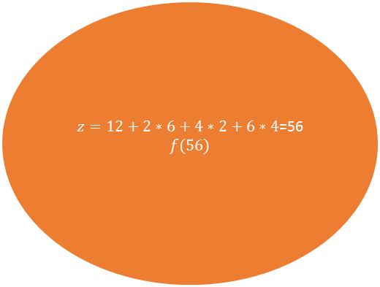
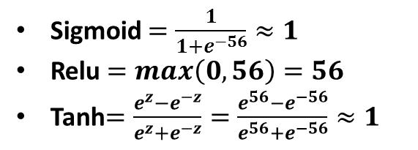
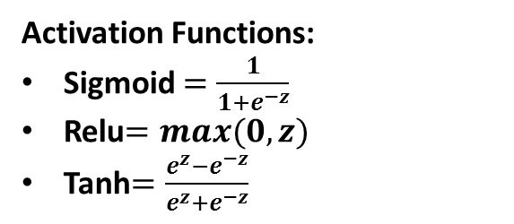
Neurons: Artificial
2
$z=12+2∗6+4∗2+6∗4$=56
$$f(56)$$
6
Activation Functions:
Sigmoid $=\frac{1}{{1+e}^{−z}}$
Relu$=max(0,z)$
Tanh$=\frac{e^{z}−e^{−z}}{e^{z}+e^{−z}}$
4
2
Inputs
4
Sigmoid $=\frac{1}{1+e^{−56}}≈1$
Relu $=max\left(0,56\right)=56$
Tanh$=\frac{e^{z}−e^{−z}}{e^{z}+e^{−z}}=\frac{e^{56}−e^{−56}}{e^{56}+e^{−56}}≈1$
6

Slide 14
Neurons: Artificial

Slide 15

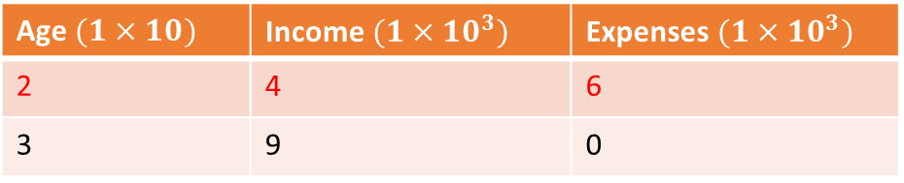
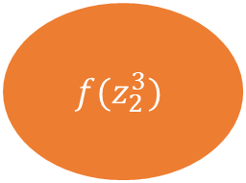


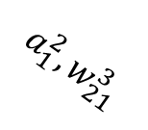
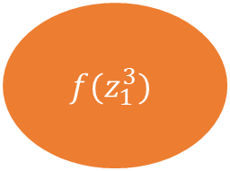
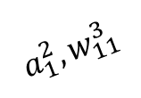
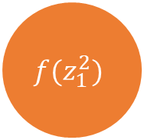
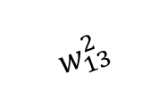
Neuron: Artificial
Age $(1×10)$ | Income $(1×10^{3})$ | Expenses $(1×10^{3})$
2 | 4 | 6
3 | 9 | 0
2
$$w_{11}^{2}$$
$$f(z_{1}^{3})$$
$$Relu, f(z)=max(0,z)$$
$$a_{1}^{2}, w_{11}^{3}$$
4
$$w_{12}^{2}$$
$$f(z_{1}^{2})$$
$$a_{1}^{2}, w_{21}^{3}$$
$$w_{13}^{2}$$
6
$$f(z_{2}^{3})$$

Slide 16
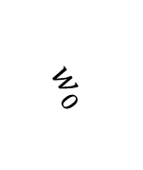
Neuron: Artificial
Age $(1×10)$ | Income $(1×10^{3})$ | Expenses $(1×10^{3})$
2 | 4 | 6
3 | 9 | 0
$$w_{0}$$
2
$$w_{11}^{2}$$
$$f(z_{1}^{3})$$
$$Relu, f(z)=max(0,z)$$
$$a_{1}^{2}, w_{11}^{3}$$
4
$$w_{12}^{2}$$
$$f(z_{1}^{2})$$
$$a_{1}^{2}, w_{21}^{3}$$
$$w_{13}^{2}$$
6
$$z_{1}^{2}=w_{0}+x1∗w_{1}+x2∗w_{2}+x3∗w_{3}$$
$$f(z_{2}^{3})$$

Slide 17
Neuron: Artificial
Age $(1×10)$ | Income $(1×10^{3})$ | Expenses $(1×10^{3})$
2 | 4 | 6
3 | 9 | 0
0.1
2
0.2
$$f(z_{1}^{3})$$
$$Relu, f(z)=max(0,z)$$
$$a_{1}^{2}, w_{11}^{3}$$
4
-0.5
$$f(z_{1}^{2})$$
$$a_{1}^{2}, w_{21}^{3}$$
1
6
$$z_{1}^{1}=w_{0}+x1∗w_{1}+x2∗w_{2}+x3∗w_{3}$$
$$f(z_{2}^{3})$$

Slide 18
Neuron: Artificial
Age $(1×10)$ | Income $(1×10^{3})$ | Expenses $(1×10^{3})$
2 | 4 | 6
3 | 9 | 0
0.1
2
0.2
$$f(z_{1}^{3})$$
$$Relu, f(z)=max(0,z)$$
$$a_{1}^{2}, w_{11}^{3}$$
4
-0.5
$$f(z_{1}^{2})$$
$$a_{1}^{2}, w_{21}^{3}$$
1
6
$$z_{1}^{2}=w_{0}+x1∗w_{1}+x2∗w_{2}+x3∗w_{3}$$
$$f(z_{2}^{3})$$
$$z_{1}^{2}=0.1+2∗0.2+4∗\left(−0.5\right)+6∗1$$

Slide 19
Neuron: Artificial
Age $(1×10)$ | Income $(1×10^{3})$ | Expenses $(1×10^{3})$
2 | 4 | 6
3 | 9 | 0
0.1
2
0.2
$$f(z_{1}^{3})$$
$$Relu, f(z)=max(0,z)$$
$$a_{1}^{2}, w_{11}^{3}$$
4
-0.5
$$f(z_{1}^{2})$$
$$a_{1}^{2}, w_{21}^{3}$$
1
6
$$z_{1}^{2}=w_{0}+x1∗w_{1}+x2∗w_{2}+x3∗w_{3}$$
$$f(z_{2}^{3})$$
$$z_{1}^{2}=0.1+2∗0.2+4∗\left(−0.5\right)+6∗1$$
$$z_{1}^{2}=4.5$$

Slide 20
Neuron: Artificial
Age $(1×10)$ | Income $(1×10^{3})$ | Expenses $(1×10^{3})$
2 | 4 | 6
3 | 9 | 0
0.1
2
0.2
$$f(z_{1}^{3})$$
$$Relu, f(z)=max(0,z)$$
$$a_{1}^{2}, w_{11}^{3}$$
4
-0.5
$$f(z_{1}^{2})$$
$$a_{1}^{2}, w_{21}^{3}$$
1
6
$$z_{1}^{2}=w_{0}+x1∗w_{1}+x2∗w_{2}+x3∗w_{3}$$
$$f(z_{2}^{3})$$
$$z_{1}^{2}=0.1+2∗0.2+4∗\left(−0.5\right)+6∗1$$
$$z_{1}^{2}=4.5$$
$$f\left(z_{1}^{2}\right)=f\left(4.5\right)=max\left(0,4.5\right)=4.5$$

Slide 21
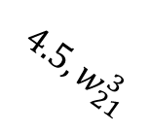

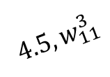
Neuron: Artificial
Age $(1×10)$ | Income $(1×10^{3})$ | Expenses $(1×10^{3})$
2 | 4 | 6
3 | 9 | 0
0.1
2
0.2
$$f(z_{1}^{3})$$
$$Relu, f(z)=max(0,z)$$
$$4.5, w_{11}^{3}$$
4
-0.5
$$f(z_{1}^{2})$$
$$z_{1}^{2}=w_{0}+w_{1}∗x_{1}$$
$$4.5, w_{21}^{3}$$
1
6
$$z_{1}^{2}=w_{0}+x1∗w_{1}+x2∗w_{2}+x3∗w_{3}$$
$$f(z_{2}^{3})$$
$$z_{1}^{2}=0.1+2∗0.2+4∗\left(−0.5\right)+6∗1$$
$$z_{1}^{1}=4.5$$
$$f\left(z_{1}^{2}\right)=f\left(4.5\right)=max\left(0,4.5\right)=4.5$$

Slide 22
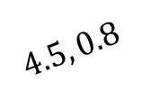

Neuron: Artificial
Age $(1×10)$ | Income $(1×10^{3})$ | Expenses $(1×10^{3})$
2 | 4 | 6
3 | 9 | 0
0.1
2
0.2
$$f(z_{1}^{3})$$
$$Relu, f(z)=max(0,z)$$
$$4.5, 0.8$$
4
-0.5
$$f(z_{1}^{2})$$
$$z_{1}^{3}=0.2+0..8∗x_{1}$$
$$4.5, w_{21}^{3}$$
1
6
$$z_{1}^{2}=w_{0}+x1∗w_{1}+x2∗w_{2}+x3∗w_{3}$$
$$f(z_{2}^{3})$$
$$z_{1}^{2}=0.1+2∗0.2+4∗\left(−0.5\right)+6∗1$$
$$z_{1}^{2}=4.5$$
$$f\left(z_{1}^{2}\right)=f\left(4.5\right)=max\left(0,4.5\right)=4.5$$

Slide 23
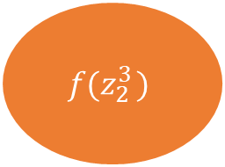

Neuron: Artificial
Age $(1×10)$ | Income $(1×10^{3})$ | Expenses $(1×10^{3})$
2 | 4 | 6
3 | 9 | 0
0.1
2
0.2
$$f(z_{1}^{3})$$
$$Relu, f(z)=max(0,z)$$
$$4.5, 0.8$$
4
-0.5
$$f(z_{1}^{2})$$
$$z_{1}^{3}=0.2+0..8∗4.5$$
$$4.5, w_{21}^{3}$$
1
6
$$z_{1}^{2}=w_{0}+x1∗w_{1}+x2∗w_{2}+x3∗w_{3}$$
$$f(z_{2 }^{3})$$
$$z_{1}^{2}=0.1+2∗0.2+4∗\left(−0.5\right)+6∗1$$
$$z_{1}^{2}=4.5$$
$$f\left(z_{1}^{2}\right)=f\left(4.5\right)=max\left(0,4.5\right)=4.5$$

Slide 24

Neuron: Artificial
Age $(1×10)$ | Income $(1×10^{3})$ | Expenses $(1×10^{3})$
2 | 4 | 6
3 | 9 | 0
0.1
2
0.2
$$f(z_{1}^{3})$$
$$Relu, f(z)=max(0,z)$$
$$4.5, 0.8$$
4
-0.5
$$f(z_{1}^{2})$$
$$z_{1}^{3}=0.2+0..8∗4.5$$
$$4.5, w_{21}^{3}$$
$$z_{1}^{3}=3.8$$
1
6
$$z_{1}^{2}=w_{0}+x1∗w_{1}+x2∗w_{2}+x3∗w_{3}$$
$$f(z_{2}^{3})$$
$$z_{1}^{2}=0.1+2∗0.2+4∗\left(−0.5\right)+6∗1$$
$$z_{1}^{2}=4.5$$
$$f\left(z_{1}^{2}\right)=f\left(4.5\right)=max\left(0,4.5\right)=4.5$$

Slide 25


Neuron: Artificial
Age $(1×10)$ | Income $(1×10^{3})$ | Expenses $(1×10^{3})$
2 | 4 | 6
3 | 9 | 0
0.1
2
0.2
$$f(z_{1}^{3})$$
$$Relu, f(z)=max(0,z)$$
$$4.5, 0.8$$
4
-0.5
$$f(z_{1}^{2})$$
$$z_{1}^{3}=0.2+0..8∗4.5$$
$$4.5, w_{21}^{3}$$
$$z_{1}^{3}=3.8$$
1
$$f\left(z_{1}^{3}\right)=f\left(3.8\right)=max\left(0,3.8\right)=3.8$$
6
$$z_{1}^{2}=w_{0}+x1∗w_{1}+x2∗w_{2}+x3∗w_{3}$$
$$f(z_{2}^{3})$$
$$z_{1}^{2}=0.1+2∗0.2+4∗\left(−0.5\right)+6∗1$$
$$z_{1}^{2}=4.5$$
$$f\left(z_{1}^{2}\right)=f\left(4.5\right)=max\left(0,4.5\right)=4.5$$

Slide 26
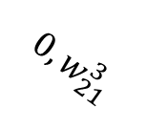
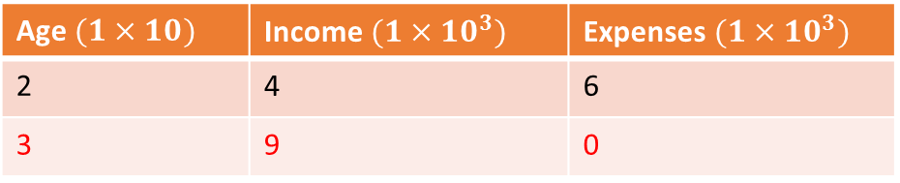
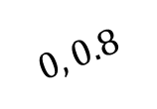



Neuron: Artificial
Age $(1×10)$ | Income $(1×10^{3})$ | Expenses $(1×10^{3})$
2 | 4 | 6
3 | 9 | 0
0.1
3
0.2
$$f(z_{1}^{3})$$
$$Relu, f(z)=max(0,z)$$
$$0, 0.8$$
9
-0.5
$$f(z_{1}^{2})$$
$$z_{1}^{3}=0.2+0..8∗0$$
$$0, w_{21}^{3}$$
$$z_{1}^{3}=0.2$$
1
$$f\left(z_{1}^{3}\right)=f\left(0.2\right)=max\left(0,0.2\right)=0.2$$
0
$$z_{1}^{2}=w_{0}+x1∗w_{1}+x2∗w_{2}+x3∗w_{3}$$
$$f(z_{2}^{3})$$
$$z_{1}^{2}=0.1+3∗0.2+9∗\left(−0.5\right)+0∗1$$
$$z_{1}^{2}=−3.8$$
$$f\left(z_{1}^{2}\right)=f\left(−3.8\right)=max\left(0,−3.8\right)=0$$

Slide 27




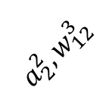

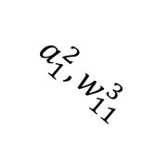

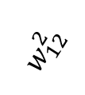
Neural Network: MLP Architecture
x1
$$w_{11}^{2}$$
$$f(z_{1}^{2})$$
$$a_{1}^{2},w_{11}^{3}$$
$$w_{12}^{2}$$
$$f(z_{1}^{3})$$
$$w_{21}^{2}$$
$$a_{2}^{2},w_{12}^{3}$$
$$f(z_{2}^{2})$$
x2
$$w_{22}^{2}$$
Output Layer
Input Layer
Hidden Layer

Slide 28
Neural Network: What is estimated?
x1
$$w_{11}^{2}$$
$$f(z_{1}^{2})$$
$$a_{1}^{2},w_{11}^{3}$$
$$w_{12}^{2}$$
$$f(z_{1}^{3})$$
$$w_{21}^{2}$$
$$a_{2}^{2},w_{12}^{3}$$
$$f(z_{2}^{2})$$
x2
$$w_{22}^{2}$$

Slide 29
Neural Network: What is estimated?
x1
$$w_{11}^{2}$$
$$f(z_{1}^{2})$$
Iteration 1
$$a_{1}^{2},w_{11}^{3}$$
$$w_{12}^{2}$$
X1 | X2 | Prediction | Actual
1 | 5 | 1 | 0
2 | 6 | 0 | 1
3 | 7 | 1 | 0
4 | 8 | 0 | 1
$$f(z_{1}^{3})$$
$$w_{21}^{2}$$
$$a_{2}^{2},w_{12}^{3}$$
$$f(z_{2}^{2})$$
x2
$$w_{22}^{2}$$

Slide 30
Neural Network: What is estimated?
x1
$$w_{11}^{2}$$
$$f(z_{1}^{2})$$
Iteration 2
$$a_{1}^{2},w_{11}^{3}$$
$$w_{12}^{2}$$
X1 | X2 | Prediction | Actual
1 | 5 | 0 | 0
2 | 6 | 1 | 1
3 | 7 | 1 | 0
4 | 8 | 0 | 1
$$f(z_{1}^{3})$$
$$w_{21}^{2}$$
$$a_{2}^{2},w_{12}^{3}$$
$$f(z_{2}^{2})$$
x2
$$w_{22}^{2}$$

Slide 31
Neural Network: What is estimated?
x1
$$w_{11}^{2}$$
$$f(z_{1}^{2})$$
Iteration 3
$$a_{1}^{2},w_{11}^{3}$$
$$w_{12}^{2}$$
X1 | X2 | Prediction | Actual
1 | 5 | 0 | 0
2 | 6 | 1 | 1
3 | 7 | 0 | 0
4 | 8 | 0 | 1
$$f(z_{1}^{3})$$
$$w_{21}^{2}$$
$$a_{2}^{2},w_{12}^{3}$$
$$f(z_{2}^{2})$$
x2
$$w_{22}^{2}$$

Slide 32
Neural Network: What is estimated?
x1
$$w_{11}^{2}$$
$$f(z_{1}^{2})$$
Iteration n
$$a_{1}^{2},w_{11}^{3}$$
$$w_{12}^{2}$$
X1 | X2 | Prediction | Actual
1 | 5 | 0 | 0
2 | 6 | 1 | 1
3 | 7 | 0 | 0
4 | 8 | 1 | 1
$$f(z_{1}^{3})$$
$$w_{21}^{2}$$
$$a_{2}^{2},w_{12}^{3}$$
$$f(z_{2}^{2})$$
x2
$$w_{22}^{2}$$

Slide 33
Neural Network: Loss Functions
To find optimum weights, Neural Networks optimize a loss function
Two most common tasks done by Neural Networks:
Regression
Classification
For regression problems, the loss function minimized is RSS
For classification problems, the loss function minimized is Cross Entropy loss/Hinge Loss

Slide 34

Neural Network: Loss Functions
Age
$$w_{11}^{2}$$
$$f(z_{1}^{2})$$
Regression
$$a_{1}^{2},w_{11}^{3}$$
$$w_{12}^{2}$$
Age | Income | Expenses | Pred | Error
20 | 30 | 300 | 420 | -120
35 | 64 | 600 | 500 | 100
…. | …. | …. | …. | …..
…. | …. | …. | …. | …..
…. | …. | …. | …. | …..
$$f(z_{1}^{3})$$
$$w_{21}^{2}$$
$$a_{2}^{2},w_{12}^{3}$$
$$f(z_{2}^{2})$$
Income
$$w_{22}^{2}$$
$$Loss=∑{\left(actual−predicted\right)}^{2}=RSS$$

Slide 35
Neural Network: Loss Functions
How does a neural network classifier works?

Slide 36
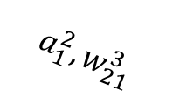


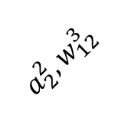




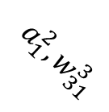
Neural Network: Loss Functions
$$a_{1}^{2},w_{11}^{3}$$
$$P_{C1}$$
x1
$$w_{11}^{2}$$
$$f(z_{1}^{2})$$
$$a_{1}^{2},w_{21}^{3}$$
$$w_{12}^{2}$$
$$P_{C2}$$
$$a_{2}^{2},w_{12}^{3}$$
$$w_{21}^{2}$$
$$a_{2}^{2},w_{22}^{3}$$
$$a_{1}^{2},w_{31}^{3}$$
$$f(z_{2}^{2})$$
x2
$$w_{22}^{2}$$
$$a_{2}^{2},w_{32}^{3}$$
$$P_{C3}$$
Classification Problem
Three Class Problem

Slide 37
Neural Network: Loss Functions
$$a_{1}^{2},w_{11}^{3}$$
$$P_{C1}$$
x1
$$w_{11}^{2}$$
$$f(z_{1}^{2})$$
$$a_{1}^{2},w_{21}^{3}$$
$$w_{12}^{2}$$
$$P_{C2}$$
Softmax Layer
$$a_{2}^{2},w_{12}^{3}$$
$$w_{21}^{2}$$
$$a_{2}^{2},w_{22}^{3}$$
$$a_{1}^{2},w_{31}^{3}$$
$$f(z_{2}^{2})$$
x2
$$w_{22}^{2}$$
$$a_{2}^{2},w_{32}^{3}$$
$$P_{C3}$$
Classification Problem
Three Class Problem

Slide 38
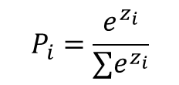
Neural Network: Loss Functions
$$a_{1}^{2},w_{11}^{3}$$
$$P_{C1}$$
x1
$$w_{11}^{2}$$
$$f(z_{1}^{2})$$
$$a_{1}^{2},w_{21}^{3}$$
$$w_{12}^{2}$$
$$P_{C2}$$
$$P_{i}=\frac{e^{z_{i}}}{∑e^{z_{i}}}$$
$$a_{2}^{2},w_{12}^{3}$$
$$w_{21}^{2}$$
$$a_{2}^{2},w_{22}^{3}$$
$$a_{1}^{2},w_{31}^{3}$$
$$f(z_{2}^{2})$$
x2
$$w_{22}^{2}$$
$$a_{2}^{2},w_{32}^{3}$$
$$P_{C3}$$
Classification Problem
Three Class Problem

Slide 39




Neural Network: Loss Functions
Row1
Prediction
Actual
$$a_{1}^{2},w_{11}^{3}$$
$$P_{C1}$$
x1
$$w_{11}^{2}$$
0.20
1
$$f(z_{1}^{2})$$
$$a_{1}^{2},w_{21}^{3}$$
$$w_{12}^{2}$$
$$P_{C2}$$
0.70
0
$$a_{2}^{2},w_{12}^{3}$$
$$w_{21}^{2}$$
$$a_{2}^{2},w_{22}^{3}$$
$$a_{1}^{2},w_{31}^{3}$$
$$f(z_{1}^{2})$$
x2
$$w_{22}^{2}$$
$$a_{2}^{2},w_{32}^{3}$$
$$P_{C3}$$
0.10
0
Classification Problem
Three Class Problem

Slide 40
Neural Network: Loss Functions
Row1
Row2
Prediction
Actual
Actual
$$a_{1}^{2},w_{11}^{3}$$
$$P_{C1}$$
x1
$$w_{11}^{2}$$
0.20
1
0
$$f(z_{1}^{2})$$
$$a_{1}^{2},w_{21}^{3}$$
$$w_{12}^{2}$$
$$P_{C2}$$
0.70
0
1
$$a_{2}^{2},w_{12}^{3}$$
$$w_{21}^{2}$$
$$a_{2}^{2},w_{22}^{3}$$
$$a_{1}^{2},w_{31}^{3}$$
$$f(z_{2}^{2})$$
x2
$$w_{22}^{2}$$
$$a_{2}^{2},w_{32}^{3}$$
$$P_{C3}$$
0.10
0
0
Classification Problem
Three Class Problem

Slide 41

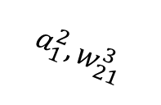



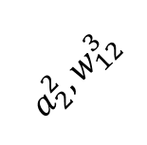
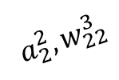

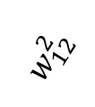





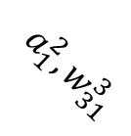
Neural Network: Loss Functions
Row1
Row2
Prediction
Actual
Actual
Error
$$P_{C1}$$
x1
$$w_{11}^{2}$$
$$a_{1}^{2},w_{11}^{3}$$
0.20
1
0
More/Less
$$f(z_{1}^{2})$$
$$a_{1}^{2},w_{21}^{3}$$
$$w_{12}^{2}$$
$$P_{C2}$$
0.70
0
1
$$a_{1}^{2},w_{31}^{3}$$
$$a_{2}^{2},w_{12}^{3}$$
$$w_{21}^{2}$$
$$a_{2}^{2},w_{22}^{3}$$
$$f(z_{2}^{2})$$
x2
$$w_{22}^{2}$$
$$a_{2}^{2},w_{32}^{3}$$
$$P_{C3}$$
0.10
0
0
Classification Problem
Three Class Problem

Slide 42
Neural Network: Loss Functions
Row1
Row2
Prediction
Actual
Actual
Error
$$P_{C1}$$
x1
$$w_{11}^{2}$$
$$a_{1}^{2},w_{11}^{3}$$
0.20
1
0
More/Less
$$f(z_{1}^{2})$$
$$a_{1}^{2},w_{21}^{3}$$
$$w_{12}^{2}$$
$$P_{C2}$$
0.70
0
1
$$a_{1}^{2},w_{31}^{3}$$
$$a_{2}^{2},w_{12}^{3}$$
$$w_{21}^{2}$$
$$a_{2}^{2},w_{22}^{3}$$
$$f(z_{2}^{2})$$
x2
$$w_{22}^{2}$$
$$a_{2}^{2},w_{32}^{3}$$
$$P_{C3}$$
0.10
0
0
Classification Problem
Three Class Problem

Slide 43

Neural Network: Loss Functions
Row1
Prediction
Actual
$$P_{C1}$$
x1
$$w_{11}^{2}$$
$$a_{1}^{2},w_{11}^{3}$$
0.20
1
$$f(z_{1}^{2})$$
$$a_{1}^{2},w_{21}^{3}$$
$$w_{12}^{2}$$
$$P_{C2}$$
0.70
0
$$a_{1}^{2},w_{31}^{3}$$
$$a_{2}^{2},w_{12}^{3}$$
$$w_{21}^{2}$$
$$a_{2}^{2},w_{22}^{3}$$
$$f(z_{2}^{2})$$
x2
$$w_{22}^{2}$$
$$a_{2}^{2},w_{32}^{3}$$
$$P_{C3}$$
0.10
0
Classification Problem
Three Class Problem
$$Loss Per Input=−∑y_{j}log⁡(p_{j})$$
-$\left[1∗\log\left(0.20\right)+0∗\log\left(0.70\right)+0∗\log\left(0.10\right)\right]=0.69$

Slide 44
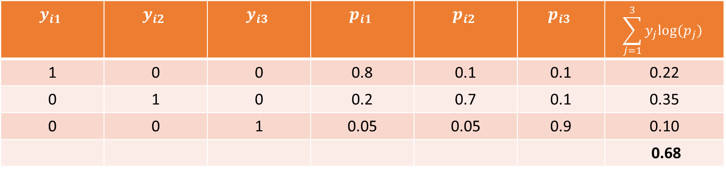
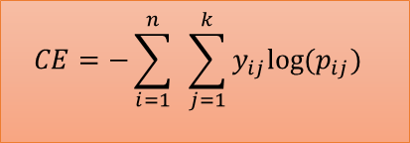
Neural Network: Loss Functions
$$y_{i1}$$ | $$y_{i2}$$ | $$y_{i3}$$ | $$p_{i1}$$ | $$p_{i2}$$ | $$p_{i3}$$ | $$\sum_{j=1}^{3}{y_{j}log⁡(p_{j})}$$
1 | 0 | 0 | 0.8 | 0.1 | 0.1 | 0.22
0 | 1 | 0 | 0.2 | 0.7 | 0.1 | 0.35
0 | 0 | 1 | 0.05 | 0.05 | 0.9 | 0.10
 |  |  |  |  |  | 0.68
$$CE=−\sum_{i=1}^{n}{ }\sum_{j=1}^{k}{y_{ij}log⁡(p_{ij})}$$

